Slide 1
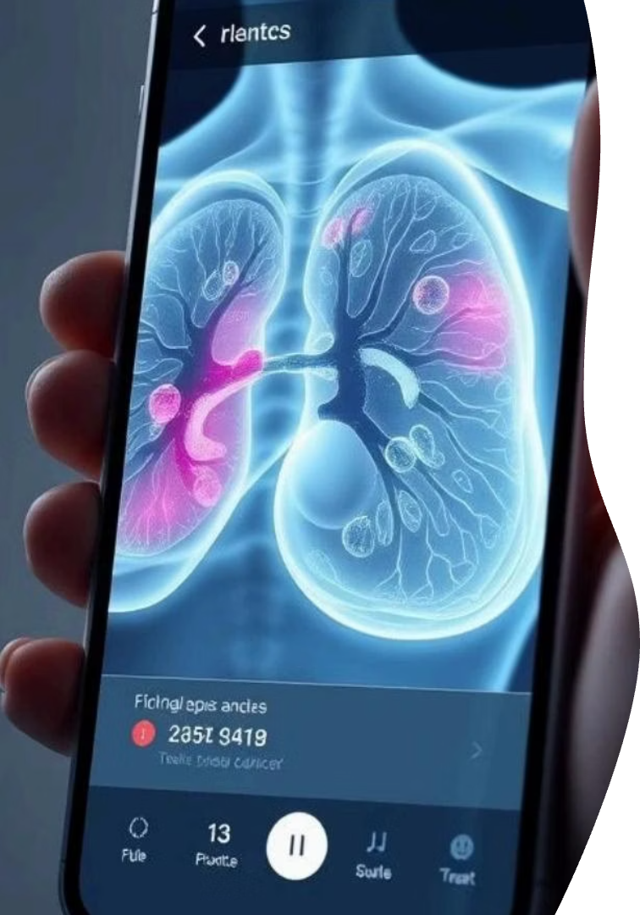
Breast Cancer Classification Application
This desktop app classifies breast cancer tumors as benign or malignant.
Built with Python and PyQt5, it aids healthcare professionals in diagnosis.

Slide 2
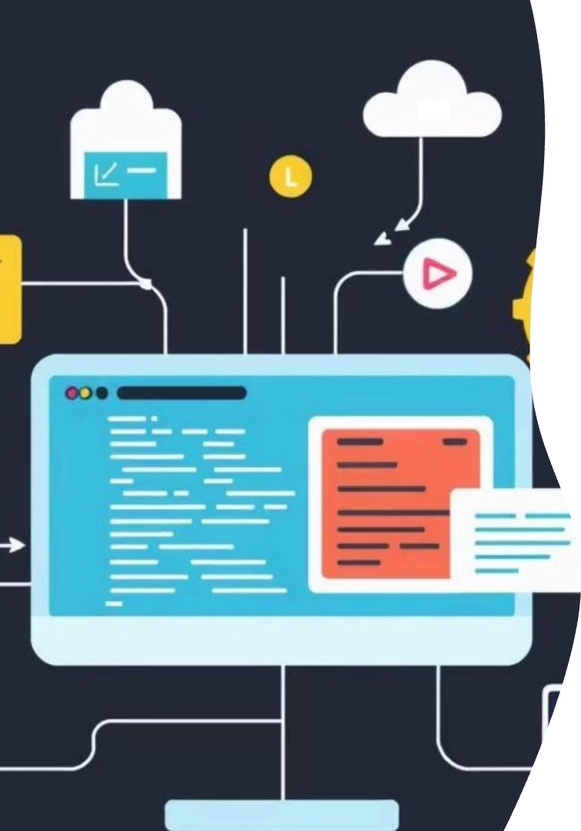
Project Objectives
GUI Development
Create an intuitive desktop app for breast cancer classification.
Data Preprocessing
Implement scaling and fuzzy feature engineering techniques.
Model Training
Use Decision Tree Classifier with hyperparameter tuning.
Visualization
Provide interactive visualizations for exploration and evaluation.

Slide 3
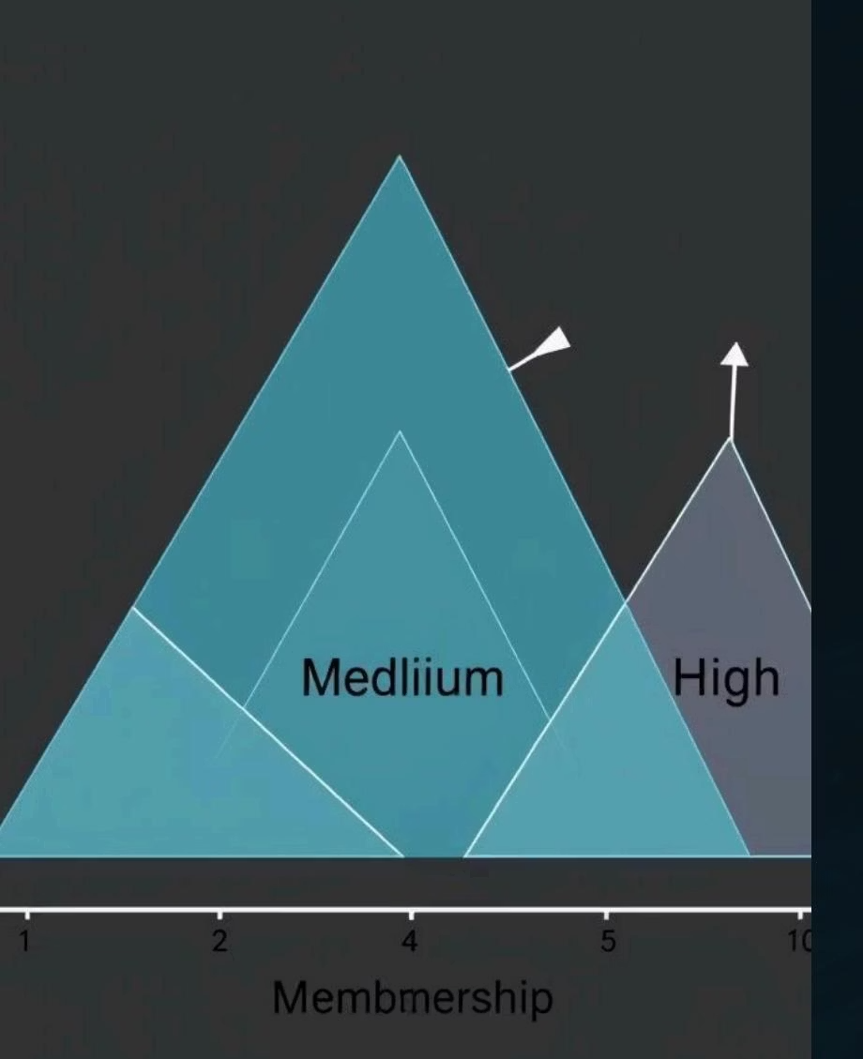
Dataset and Preprocessing
Dataset Details
Preprocessing Steps
UCI Breast Cancer Wisconsin dataset with 569 instances and 30 features.
Loading and label encoding
Labels indicate malignant (M) or benign (B) tumors.
Splitting into training and testing sets
Scaling features with Min-Max normalization

Slide 4

Fuzzy Feature Engineering
Applied fuzzy logic to radius1, area1, and texture1 features.
Computed low, medium, and high membership functions using triangular shapes.
This captures uncertainty and improves classification accuracy.

Slide 5
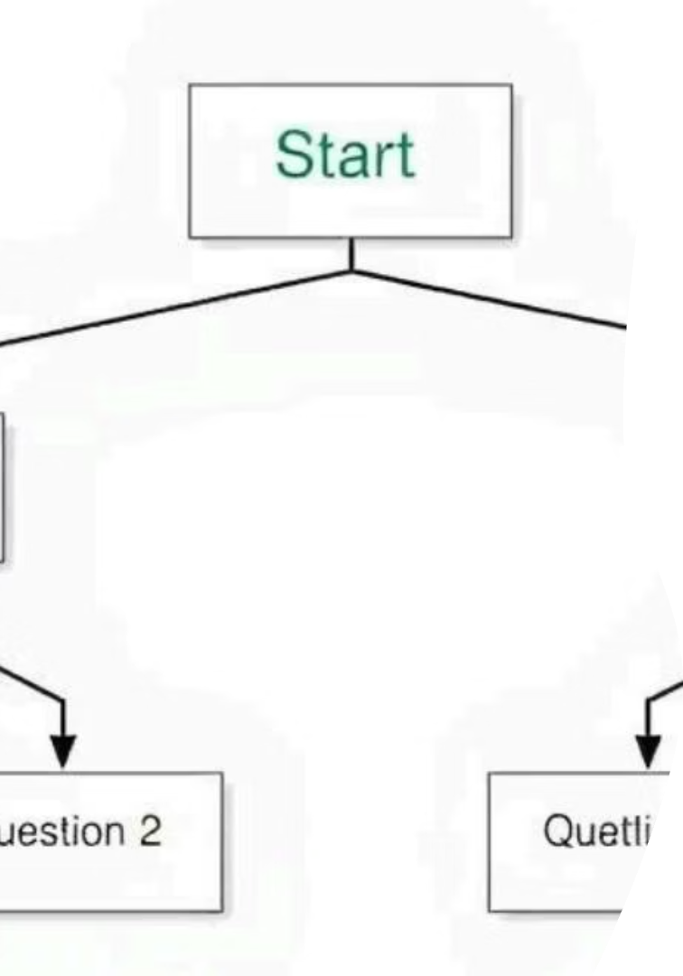
Model Training Approach
1
Decision Tree Classifier
2
Hyperparameter Tuning
Chosen for interpretability and effectiveness.
Used Hill Climbing and Grid Search to optimize tree depth.
3
Optimal Model
Selected based on balanced accuracy and complexity.

Slide 6
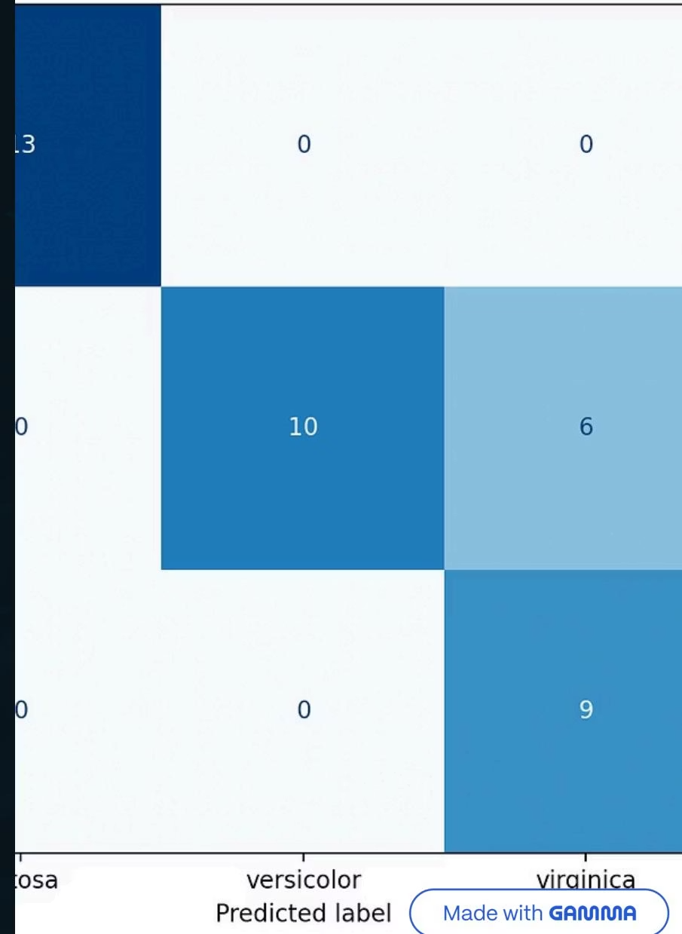
Evaluation Metrics
Accuracy
Precision & Recall
Confusion Matrix
Classification Report
Measures overall model correctness.
Assess correct identification of malignant and benign cases.
Visualizes true vs. predicted classifications.
Summarizes precision, recall, and F1-score per class.

Slide 7
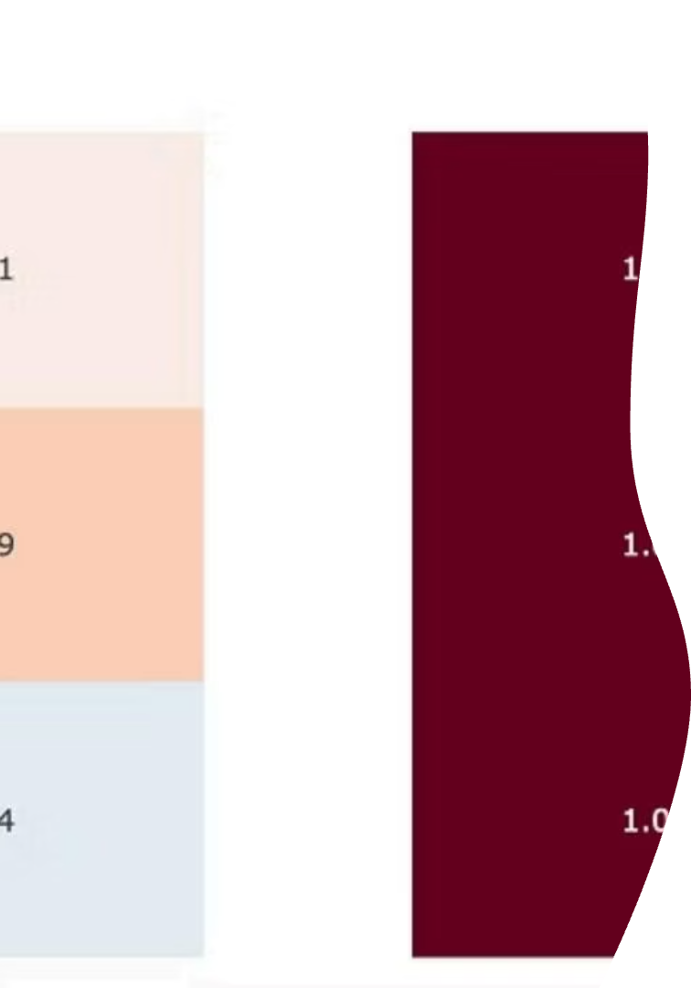




Application Features Overview
Data Exploration
Load dataset, view data info and tables.
Visualizations
Select features and display various plots.
Model Training
Set max tree depth, train model, and view results.
Evaluation
Choose metrics, plot, and analyze results.

Slide 8

Results and Performance
The model achieved high accuracy on training data.
Test set evaluation showed good precision and recall.
Results validate the model as a diagnostic support tool.

Slide 9

Conclusion
The app integrates preprocessing, fuzzy features, decision tree training, and evaluation.
It offers a user-friendly GUI to assist early detection and diagnosis accuracy.

Slide 10
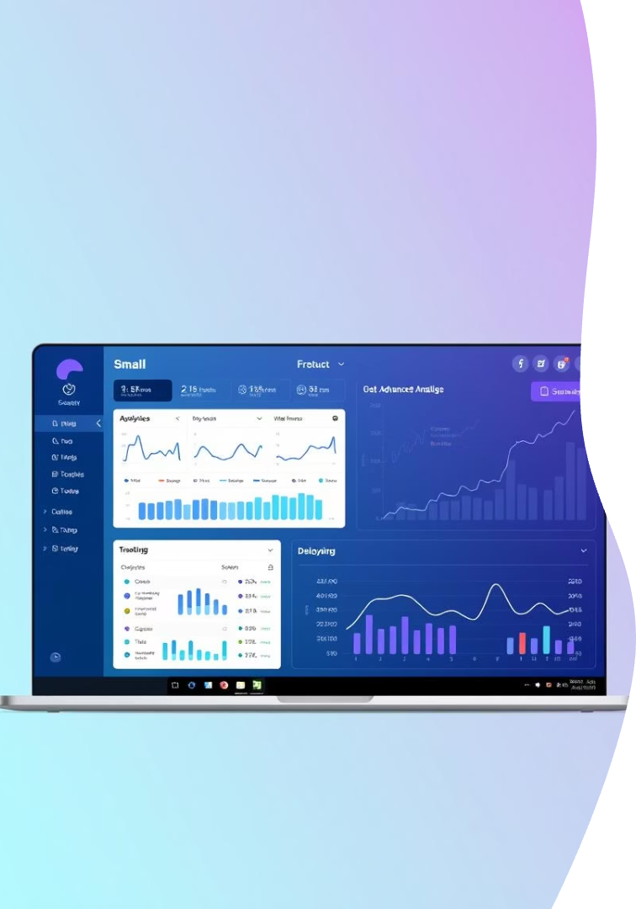
Future Work and Enhancements
Additional Algorithms
Incorporate more classification methods to improve accuracy.
Cross-Validation
Implement to ensure model robustness and generalization.
GUI Enhancements
Improve user experience and interface design.
Web Deployment
Make the application accessible online for wider use.

